Slide 1
DATA ANALYSIS ON H1B DATA
INTRODUCTION TO DATA SCIENCE 601
Presented by: WV62651

Slide 2
Why is it important to analyze H-1B data?
H-1B visas are issued to foreign workers in speciality occupations who meet certain requirements.
H-1B data is collected by the United States Citizenship and Immigration Services (USCIS).
H-1B data can be used to understand trends in the immigration of skilled workers to the United States.
H-1B data can also be used to identify areas where there is a shortage of skilled workers.
Some of the challenges of analyzing H-1B data:
H-1B data is complex and can be difficult to clean and prepare for analysis.
H-1B data is also subject to change, as USCIS policies and procedures change over time.

Slide 3
DATA SET ATTRIBUTES:
The dataset consists of 209360 observations with 11 attributes representing the employers who have submitted petitions to employ H-1B nonimmigrant workers.
# Column Non-Null Count Dtype
0 Fiscal Year 209360 non-null int64
1 Employer 209348 non-null object
2 Initial Approval 209360 non-null int64
3 Initial Denial 209360 non-null int64
4 Continuing Approval 209360 non-null int64
5 Continuing Denial 209360 non-null int64
6 NAICS 209360 non-null int64
7 Tax ID 208849 non-null float64
8 State 206872 non-null object
9 City 206876 non-null object
10 ZIP 206862 non-null float64
dtypes: float64(2), int64(6), object(3)
memory usage: 17.6+ MB

Slide 4
DATA CLEANING and Wrangling
Fiscal Year | Employer | Initial Approval | Initial Denial | Continuing Approval | Continuing Denial | NAICS | Tax ID | State | City | ZIP
0 | 2023 | NaN | 1 | 0 | 0 | 0 | 51 | 8070.0 | DE | WILMINGTON | 19801.0
1 | 2023 | 0965688 BC LTD DBA PROCOGIA | 0 | 0 | 1 | 0 | 51 | 209.0 | WA | SEATTLE | 98101.0
2 | 2023 | 1 800 CONTACTS INC | 0 | 0 | 1 | 0 | 42 | 1643.0 | NaN | NaN | NaN
3 | 2023 | 1 800 CONTACTS INC | 0 | 0 | 1 | 0 | 42 | 1643.0 | UT | DRAPER | 84020.0
4 | 2023 | 1 800 FLOWERS COM INC | 0 | 0 | 2 | 0 | 45 | 7311.0 | NY | JERICHO | 11753.0
Cleaning the data with employer as null, because it's must field in the I-129 application to be filled. There are 12 rows of data with null from above observations.
For the fields like 'Initial Approval', 'Initial Denial', 'Continuing Approval', and 'Continuing Denial' have the scrap data, considering the 0 or 1 as the binary notations for yes or no condition and removing the cells which has the scrap data.

Slide 5
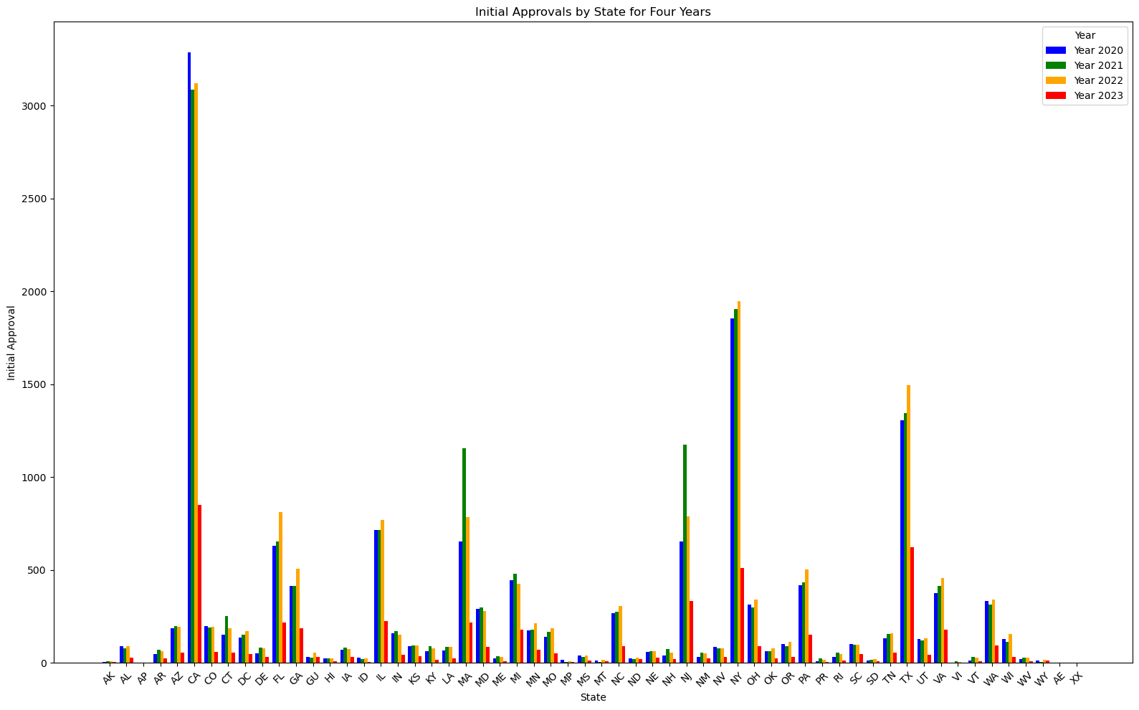
DATA ANALYSIS ON INITIAL APPROVAL

Slide 6
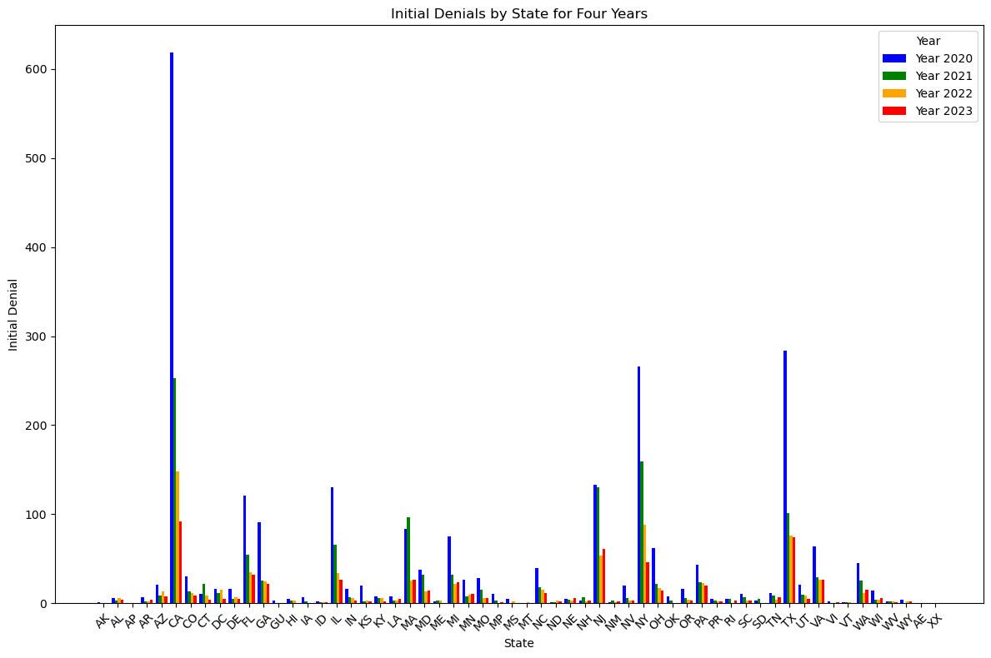
DATA ANALYSIS ON INITIAL Denial

Slide 7
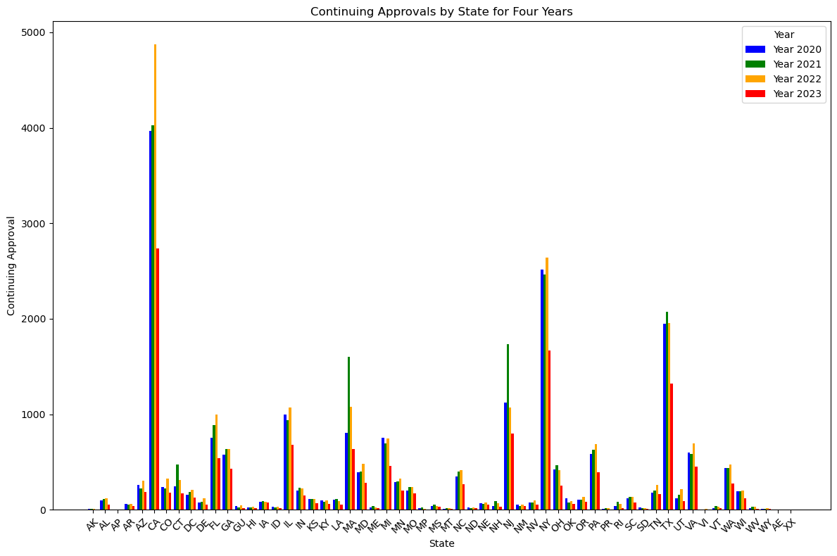
DATA ANALYSIS ON Continuing Approval

Slide 8
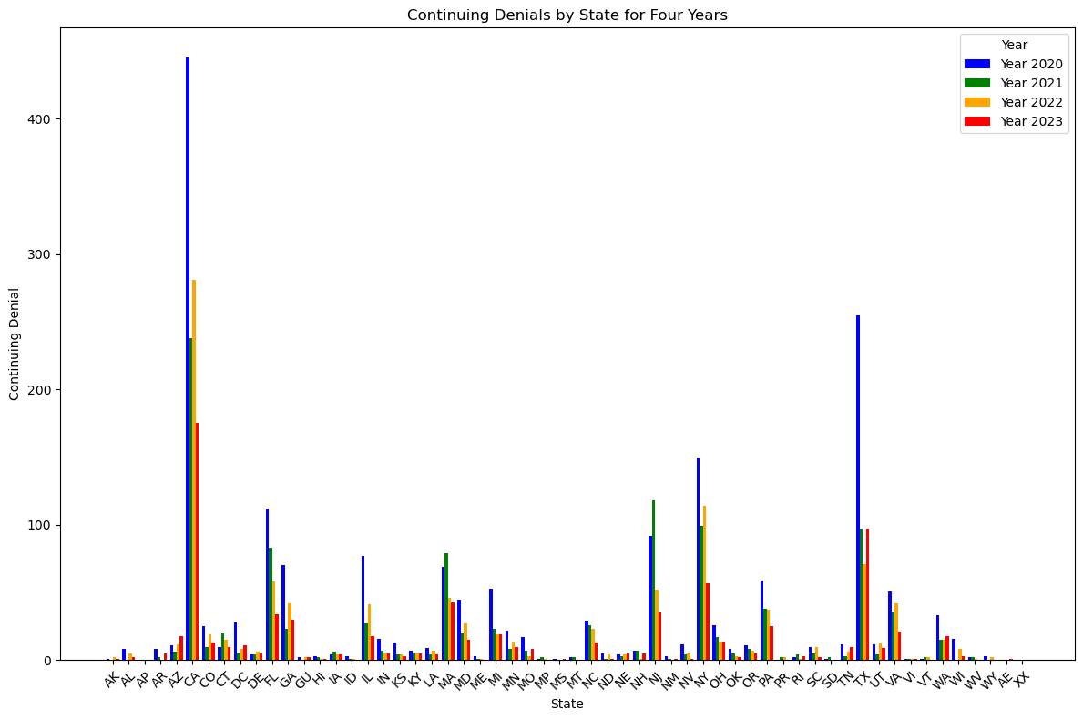
DATA ANALYSIS ON Continuing DENIAL

Slide 9
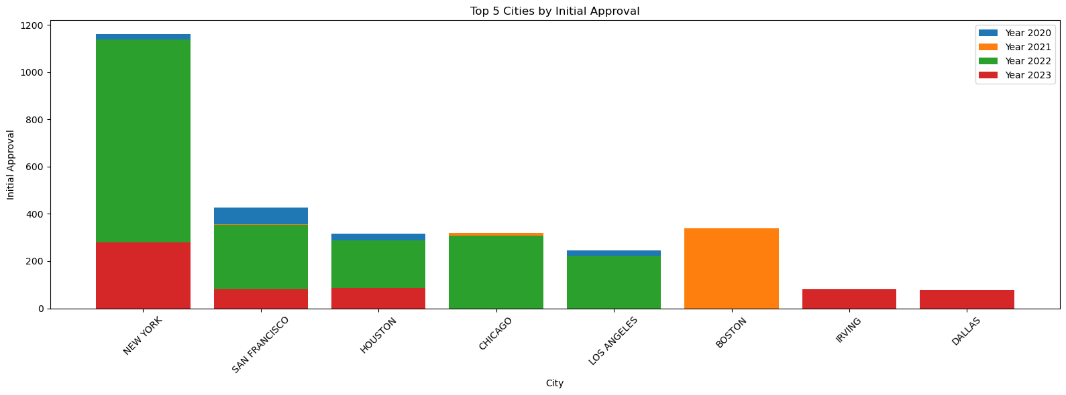
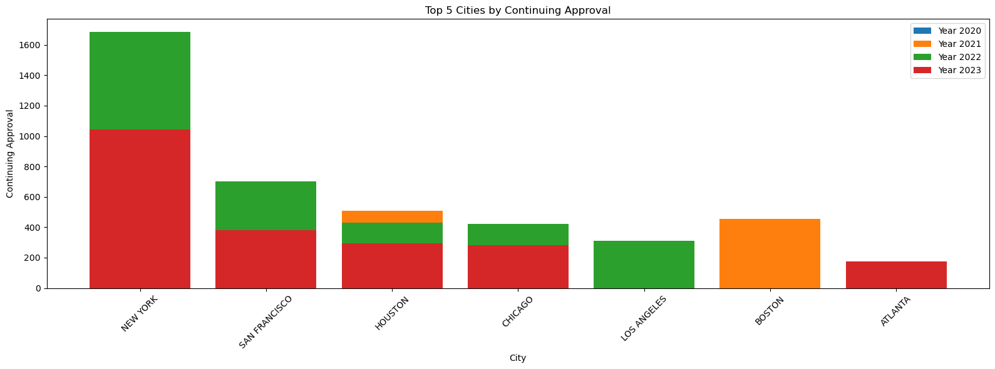
DATA ANALYSIS ON CITIES

Slide 10
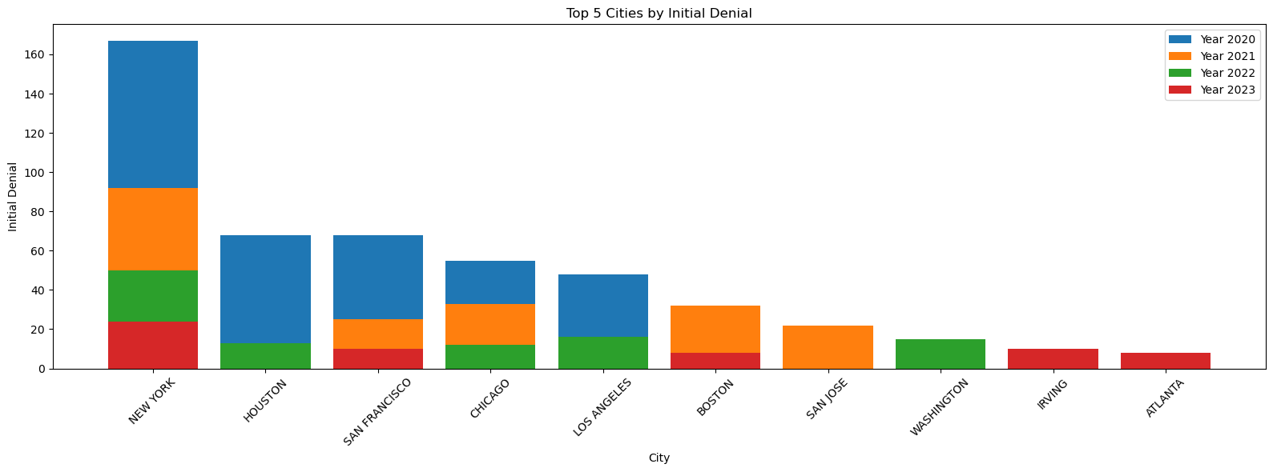
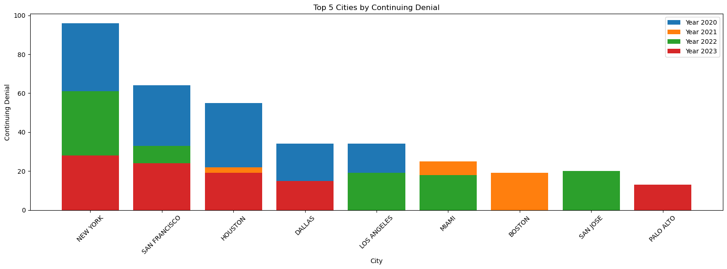
DATA ANALYSIS ON CITIES

Slide 11
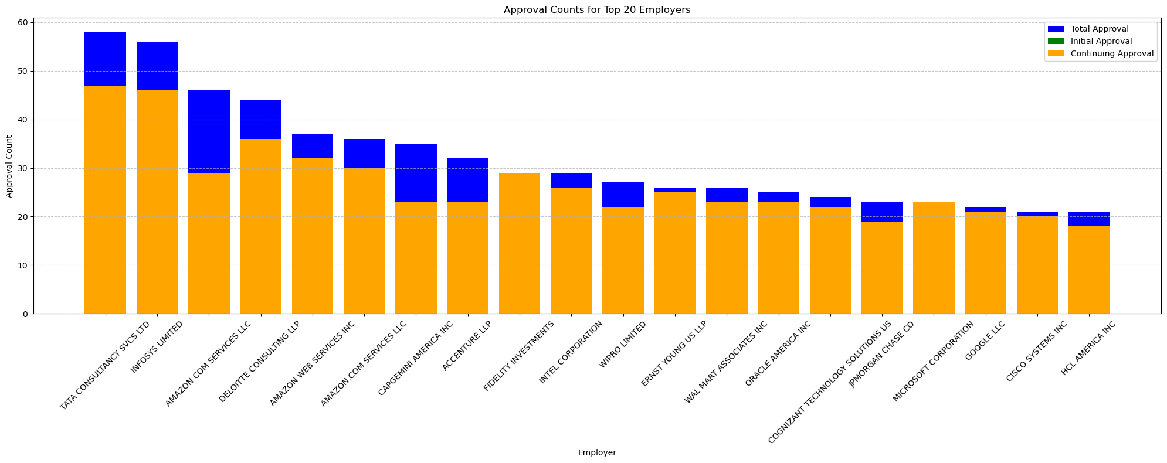
DATA ANALYSIS ON EMPLOYER

Slide 12
CONCLUSION
Numerous inferences can be made after analyzing the above graphics and data set:
First Authorizations: The number of initial approvals is comparatively larger in states like Texas, New York, and California.
First Refusals: New York, Texas, and California show higher rates of initial denials, which may be related to strict standards or legal obligations.
Sustained Authorizations: Texas, New York, and California have greater percentages of Continuing Approvals, which suggests that related businesses have been there for a long time.
Persisting Defiant: Continuing Denials are generally lower in NAICS Code 99 firms than in other categories.
The Employer TATA CONSULTANCY SVCS LTD has highest approval rate among all.
Anomalies:
Certain states exhibit very high or low numbers, which could be related to particular regional variables or local regulations.

